Slide 1

PIP2001 Capstone Project
Review-0
Security & Surveillance For Teachers And Students
Batch Number: CCS-G29
Roll Number | Student Name
20211CCS0065 | Chandrashekhar S
20211CCS0067 | Shubha K A
20211CCS0104 | Augustian P B
20211CCS0131 | Kavya Jaishree
Under the Supervision of,
Ms. Soumya
Assistant Professor
School of Computer Science and Engineering
Presidency University
Name of the Program: B.Tech
Name of the HoD: Dr. Anandaraj S P
Name of the Program Project Coordinator: Dr. Sharmasth Vali Y
Name of the School Project Coordinators: Dr. Sampath A K / Dr. Abdul Khadar A / Mr. Md Ziaur Rahman

Slide 2
Content
Problem Statement
Analysis of Problem Statement
Timeline of the Project
References

Slide 3
Problem Statement Number: PSCS212
Organization : Cisco DevNet
Category : Software
Problem Description : Although we can use the Firepower Management Control GUI to edit and create Access Control Policies, if a TEACHER would
like to add/remove URLs in our URL Filtering Policy, we need a more user-friendly solution.
• Thus we can create an administrator webpage to be used by teachers, where they can edit Access Control Policies.
• This webpage will ask for relevant information(base on request parameters), and send a POST/GET request using Firepower’s REST API to edit policies in FMC.

Slide 4
Problem Statement Number:
• (The webpage can be a simple Flask+Bootstrap+Python webpage so we can run
our Python scripts that take advantage of Firepower’s REST API.)
• User Auth will be handled by creating an Identity Policy in FMC loaded from a
directory server, powered using Microsoft Active Directory, which contains login
credentials of all students as well as their respective groups.
Difficulty Level: Simple

Slide 5
Analysis of Problem Statement
Technology Stack Components:
Firepower's REST API: API for automating and managing Cisco Firepower services
Microsoft Active Directory: Directory service for managing network resources and users.
Firepower Threat Defense (FTD) v6.3: Cisco's integrated firewall and threat protection solution.
Firepower Management Center (FMC) v6.3: Centralized management platform for Firepower devices.
Flask + Bootstrap + Python: Web development stack for building responsive web applications using Flask (Python framework) and Bootstrap (CSS framework).

Slide 6
Analysis of Problem Statement (contd...)
Software and Hardware Requirements:
Software Requirements:
Development Environment
Cisco Firepower Software
Authentication
Database (Optional)
Web Server
Operating System
Hardware Requirements:
Development Machine
Storage
RAM
Processor
Network Requirements
Local Network Access

Slide 7
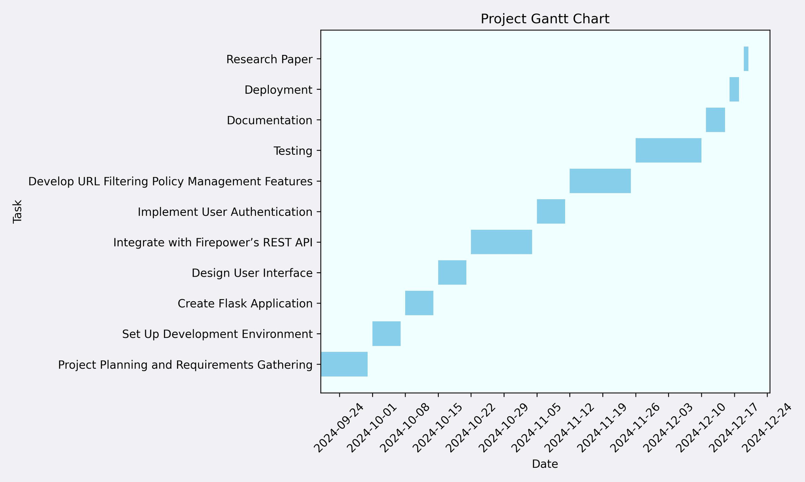
Timeline of the Project (Gantt Chart)

Slide 8
References
Livermore, CA (United States), L. L. N. L. (. (29 April 2002). A Guide to Microsoft Active Directory (AD) Design.
https://www.osti.gov/servlets/purl/15013495
Purna, B. (2020). Role-based User Access Control in MERN Stack applications. https://www.theseus.fi/bitstream/handle/10024/343968/Thesis_Purna_Baral.pdf?sequence=2&isAllowed=y
Rajib, N. (2017). Cisco Firepower Threat Defense (FTD): Configuration and Troubleshooting Best Practices for the Next-Generation Firewall (NGFW), Next-Generation Intrusion Prevention System (NGIPS), and Advanced Malware Protection (AMP). Pearson Education. https://www.google.co.in/books/edition/Cisco_Firepower_Threat_Defense_FTD/OBBADwAAQBAJ?hl=en&gbpv=0

Slide 9


